Slide 1
Quantum Guardians
Week 3
Abby, Eric, Eva, Nikki

Slide 2
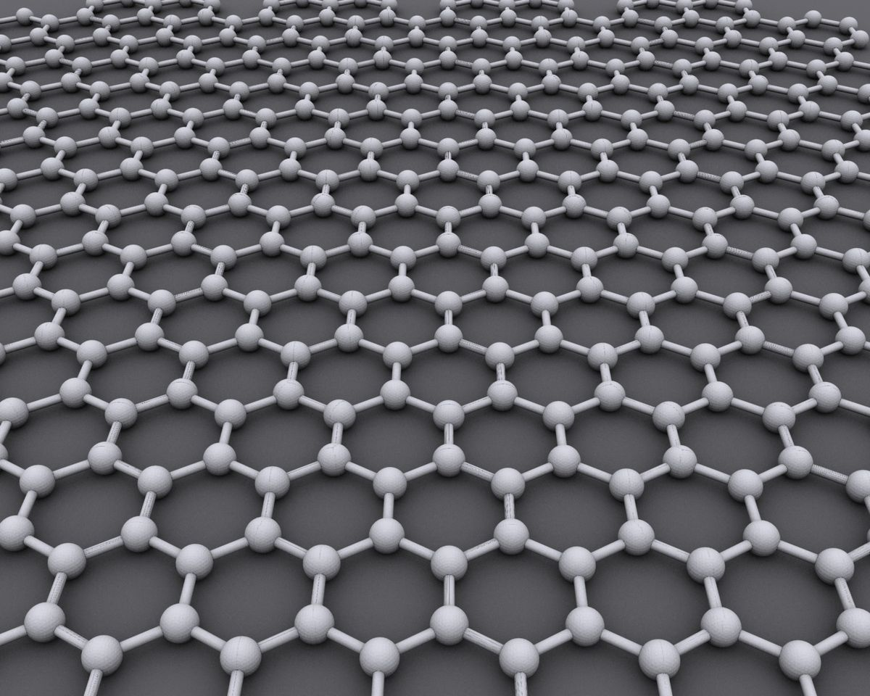
Graphene
Flat sheet of carbon just one atom thick
Carbon bonded to 3 other Carbon atoms in trigonal planar form
Graphene sheets can come from graphite flakes (many sheets of graphene stacked)
Need to exfoliate to isolate these sheets

Slide 3
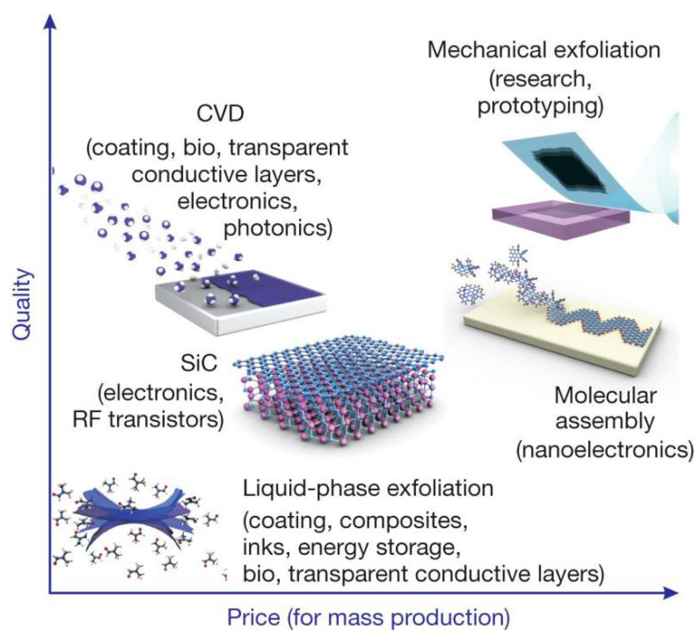
Exfoliation
Scotch Tape
Large Scale Growth
Layer Resolved Transfer

Slide 4
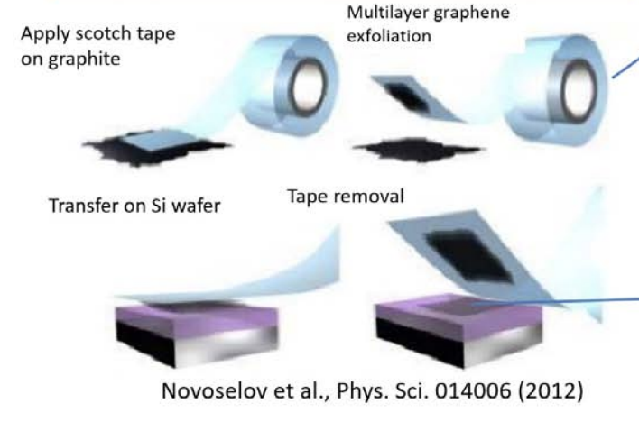
Scotch Tape
Apply scotch tape on graphite and detach the graphite from surface.
Fold over the Scotch tape many times at different locations to make multiple clones of exfoliated graphite all over the sticky side of tape
Place graphite with reduced number of layers on the tape, on the Si substrate and press it hard
Detach the tape

Slide 5
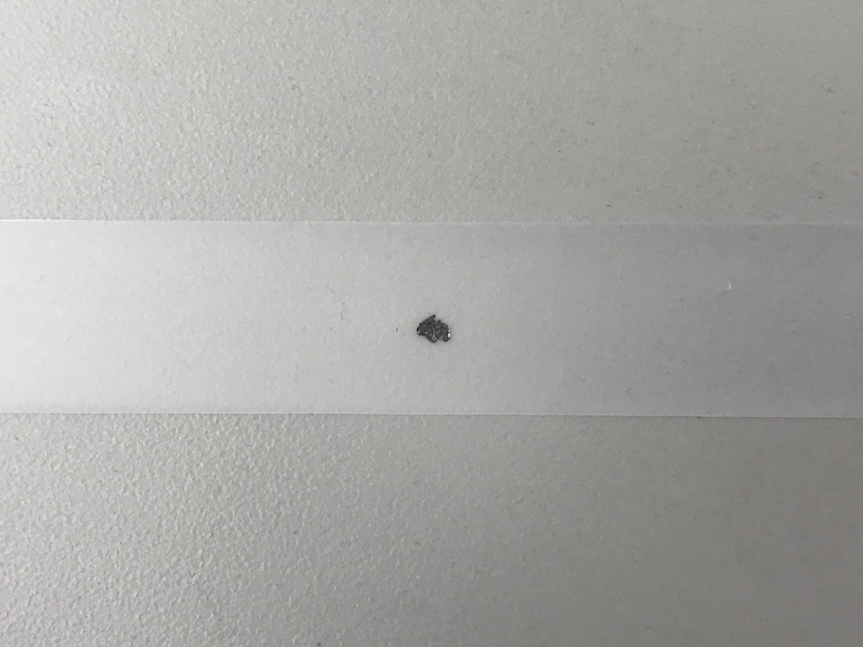
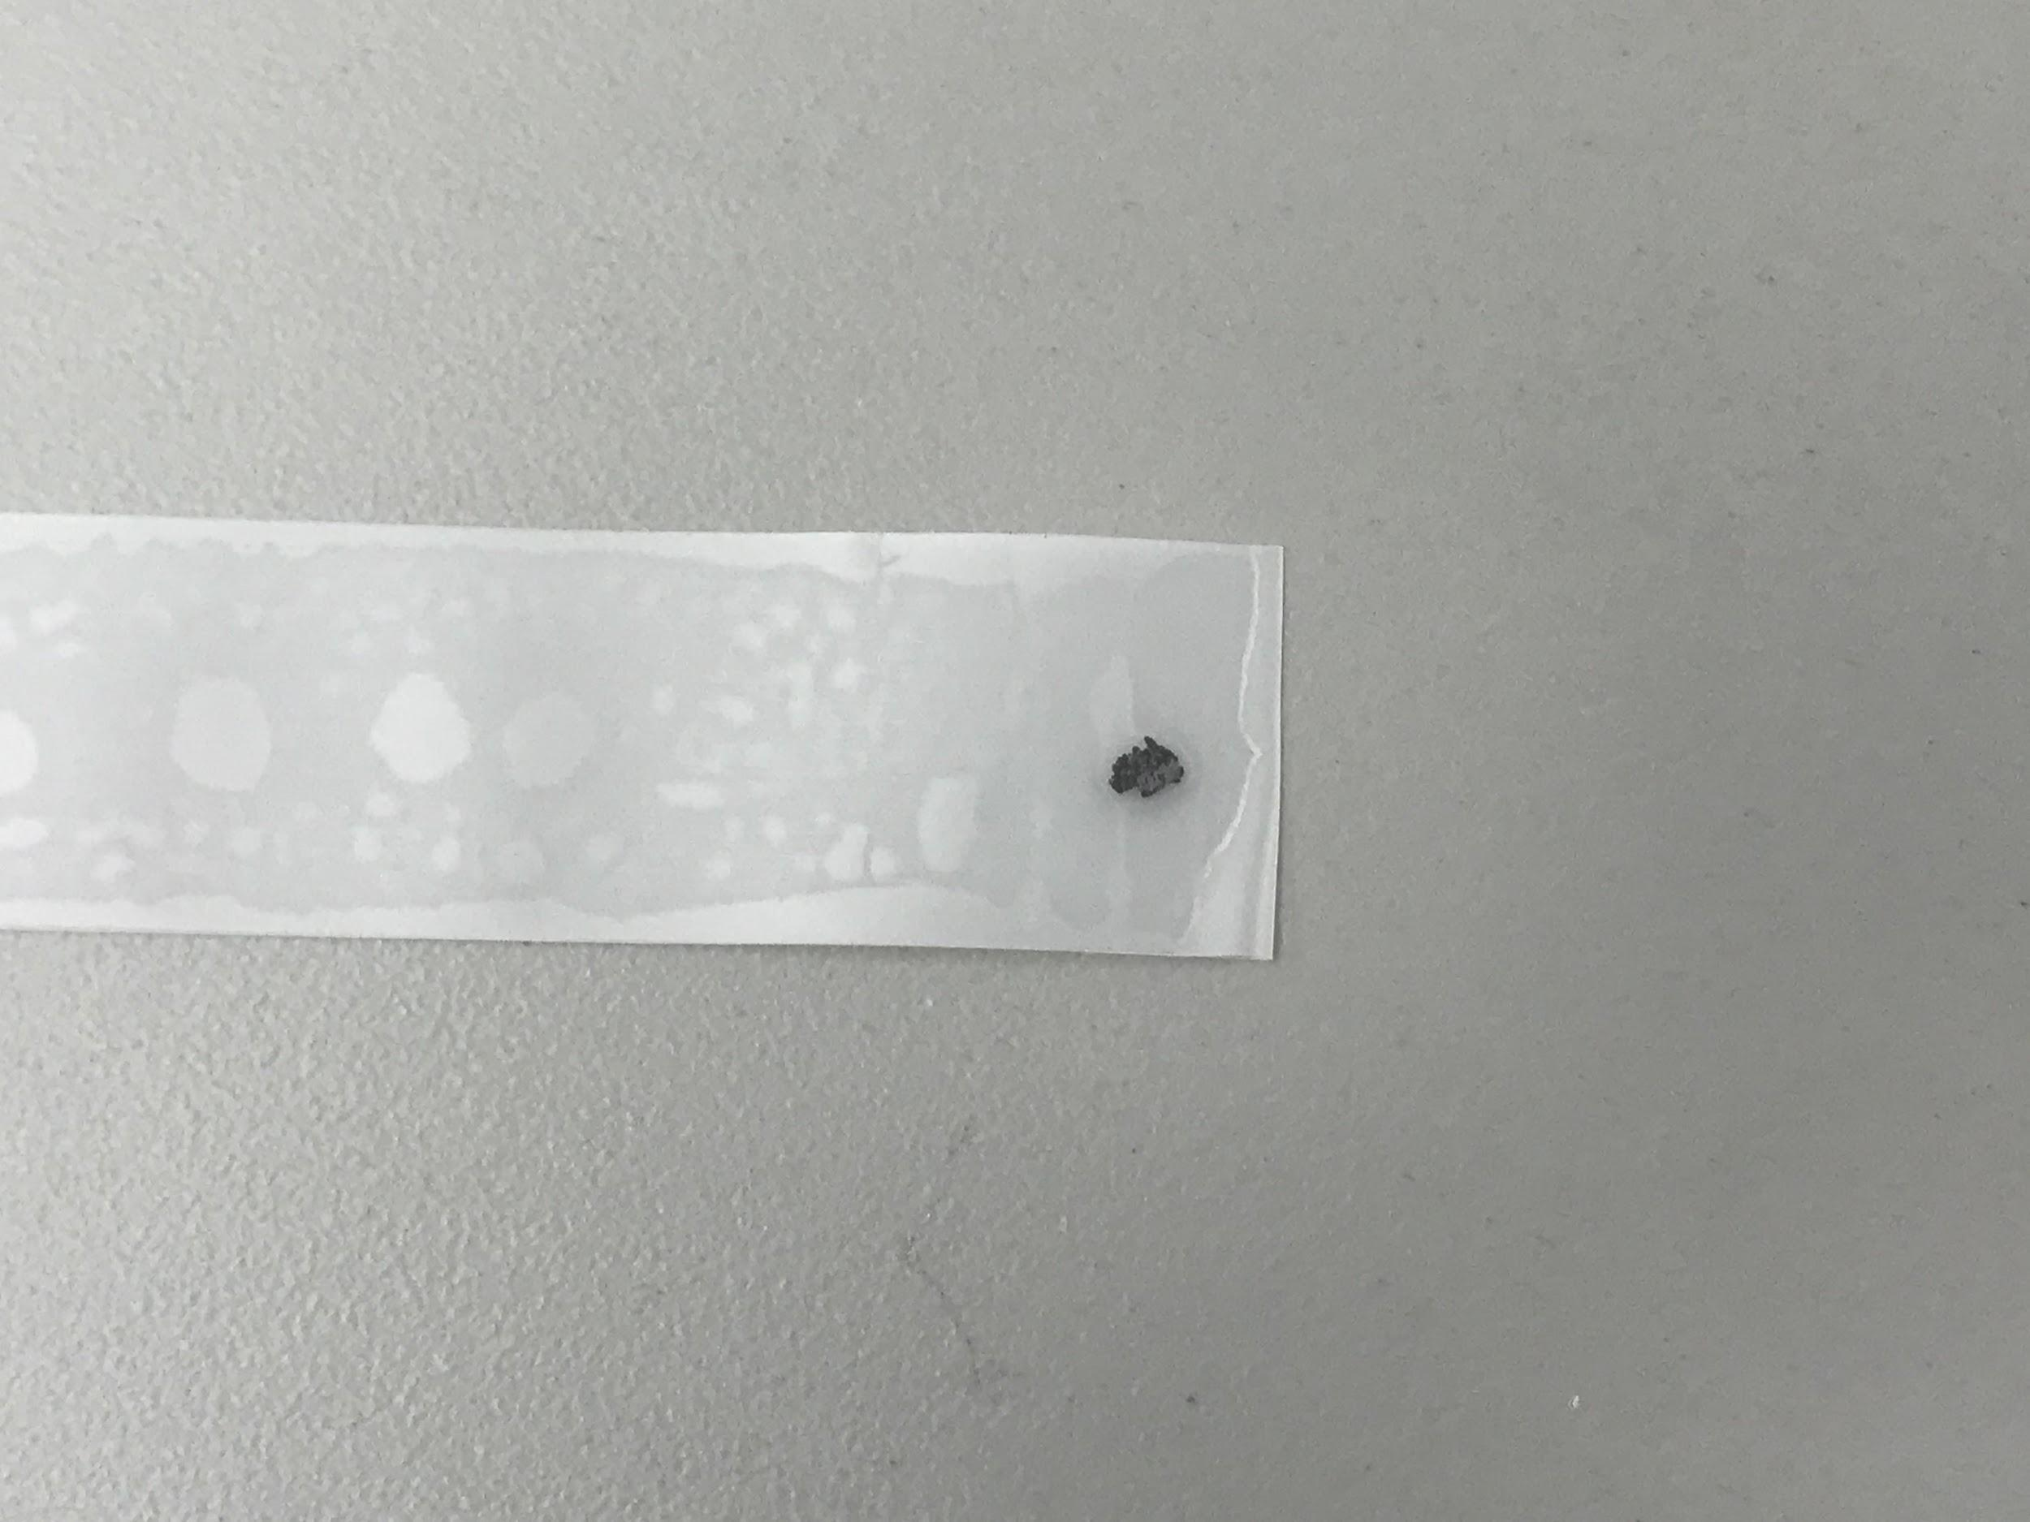
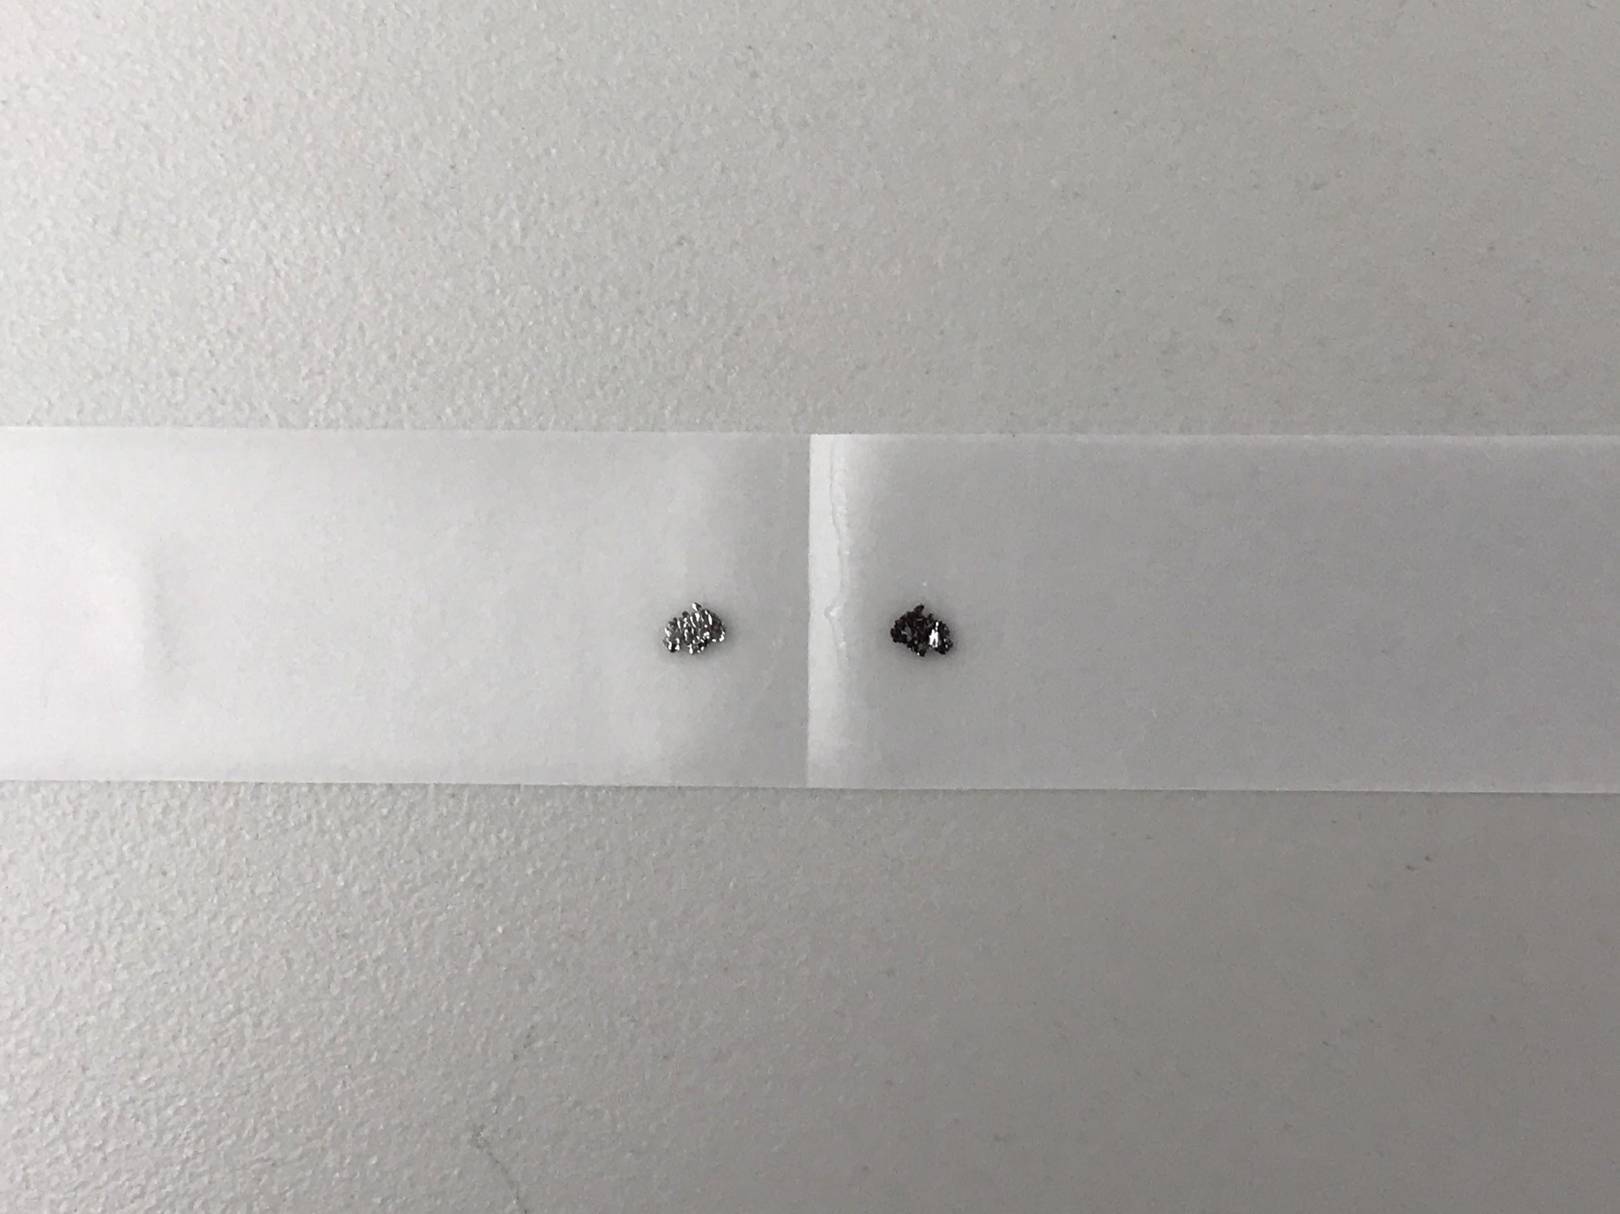
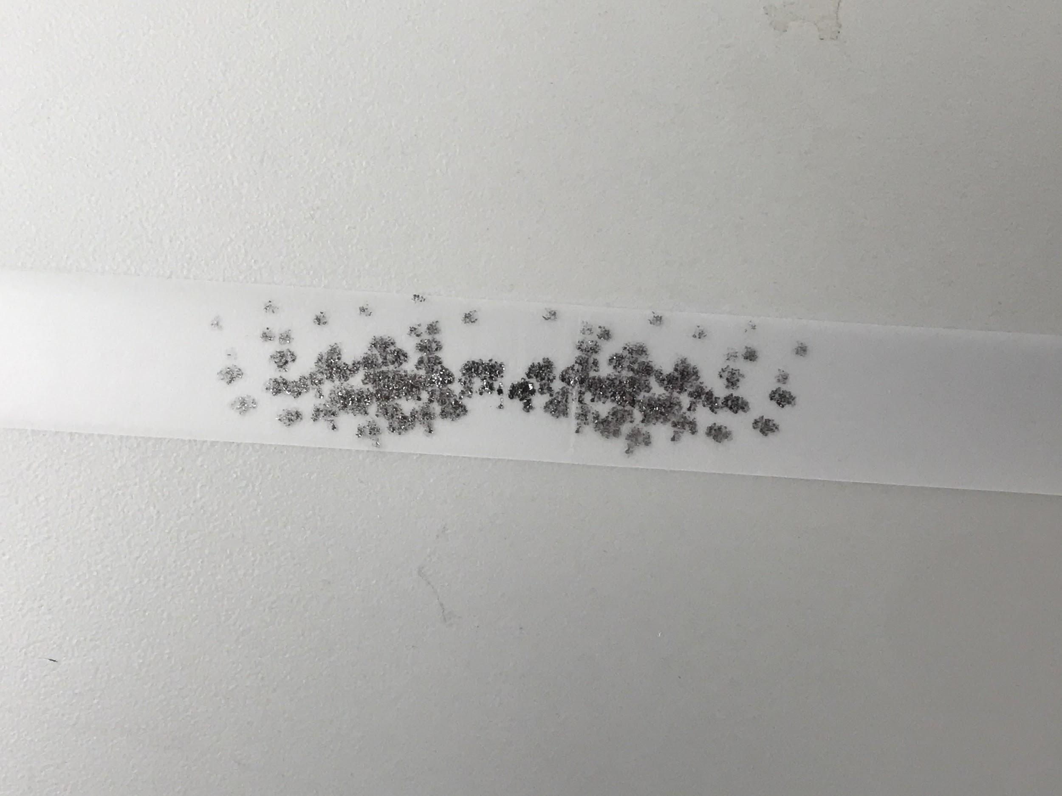
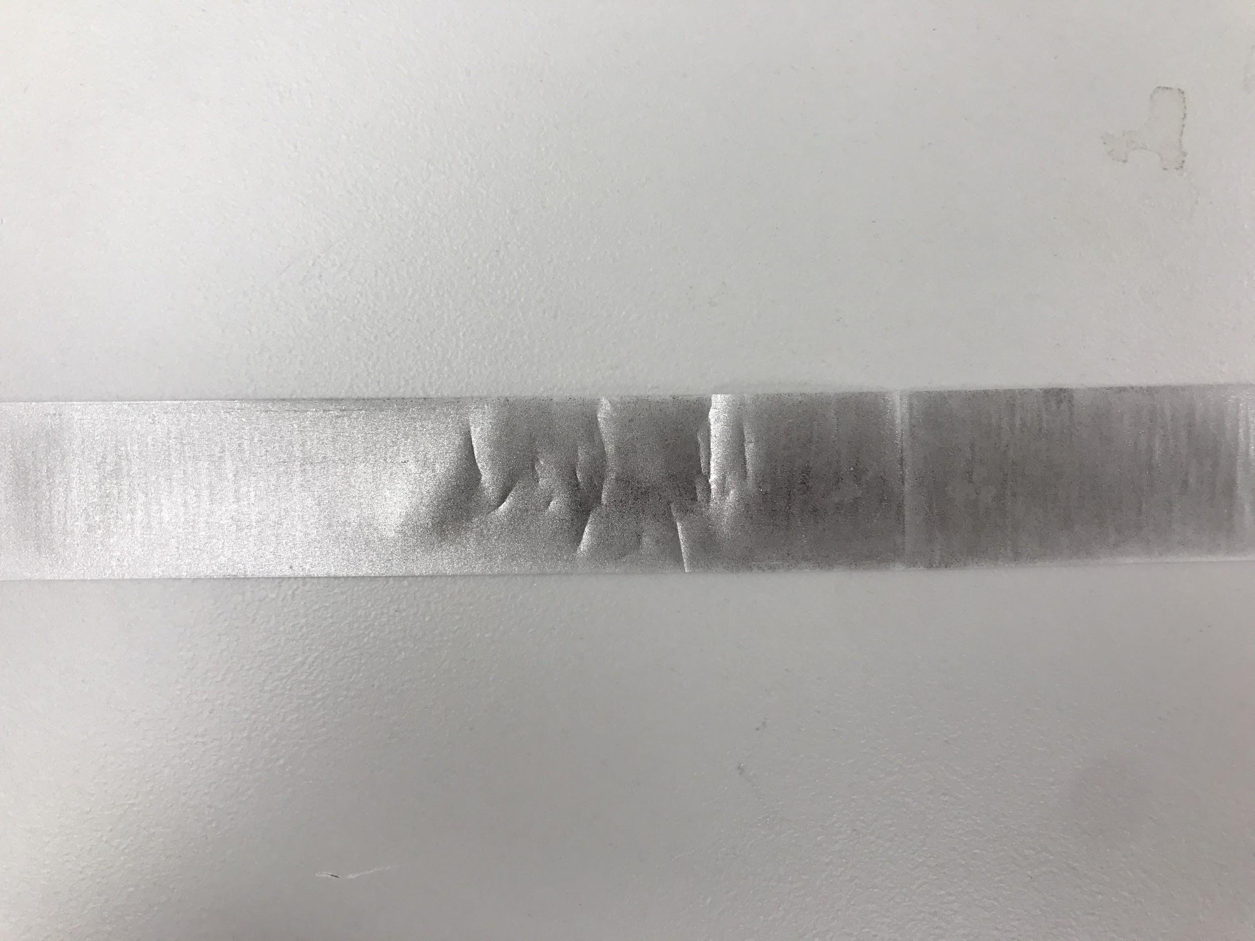
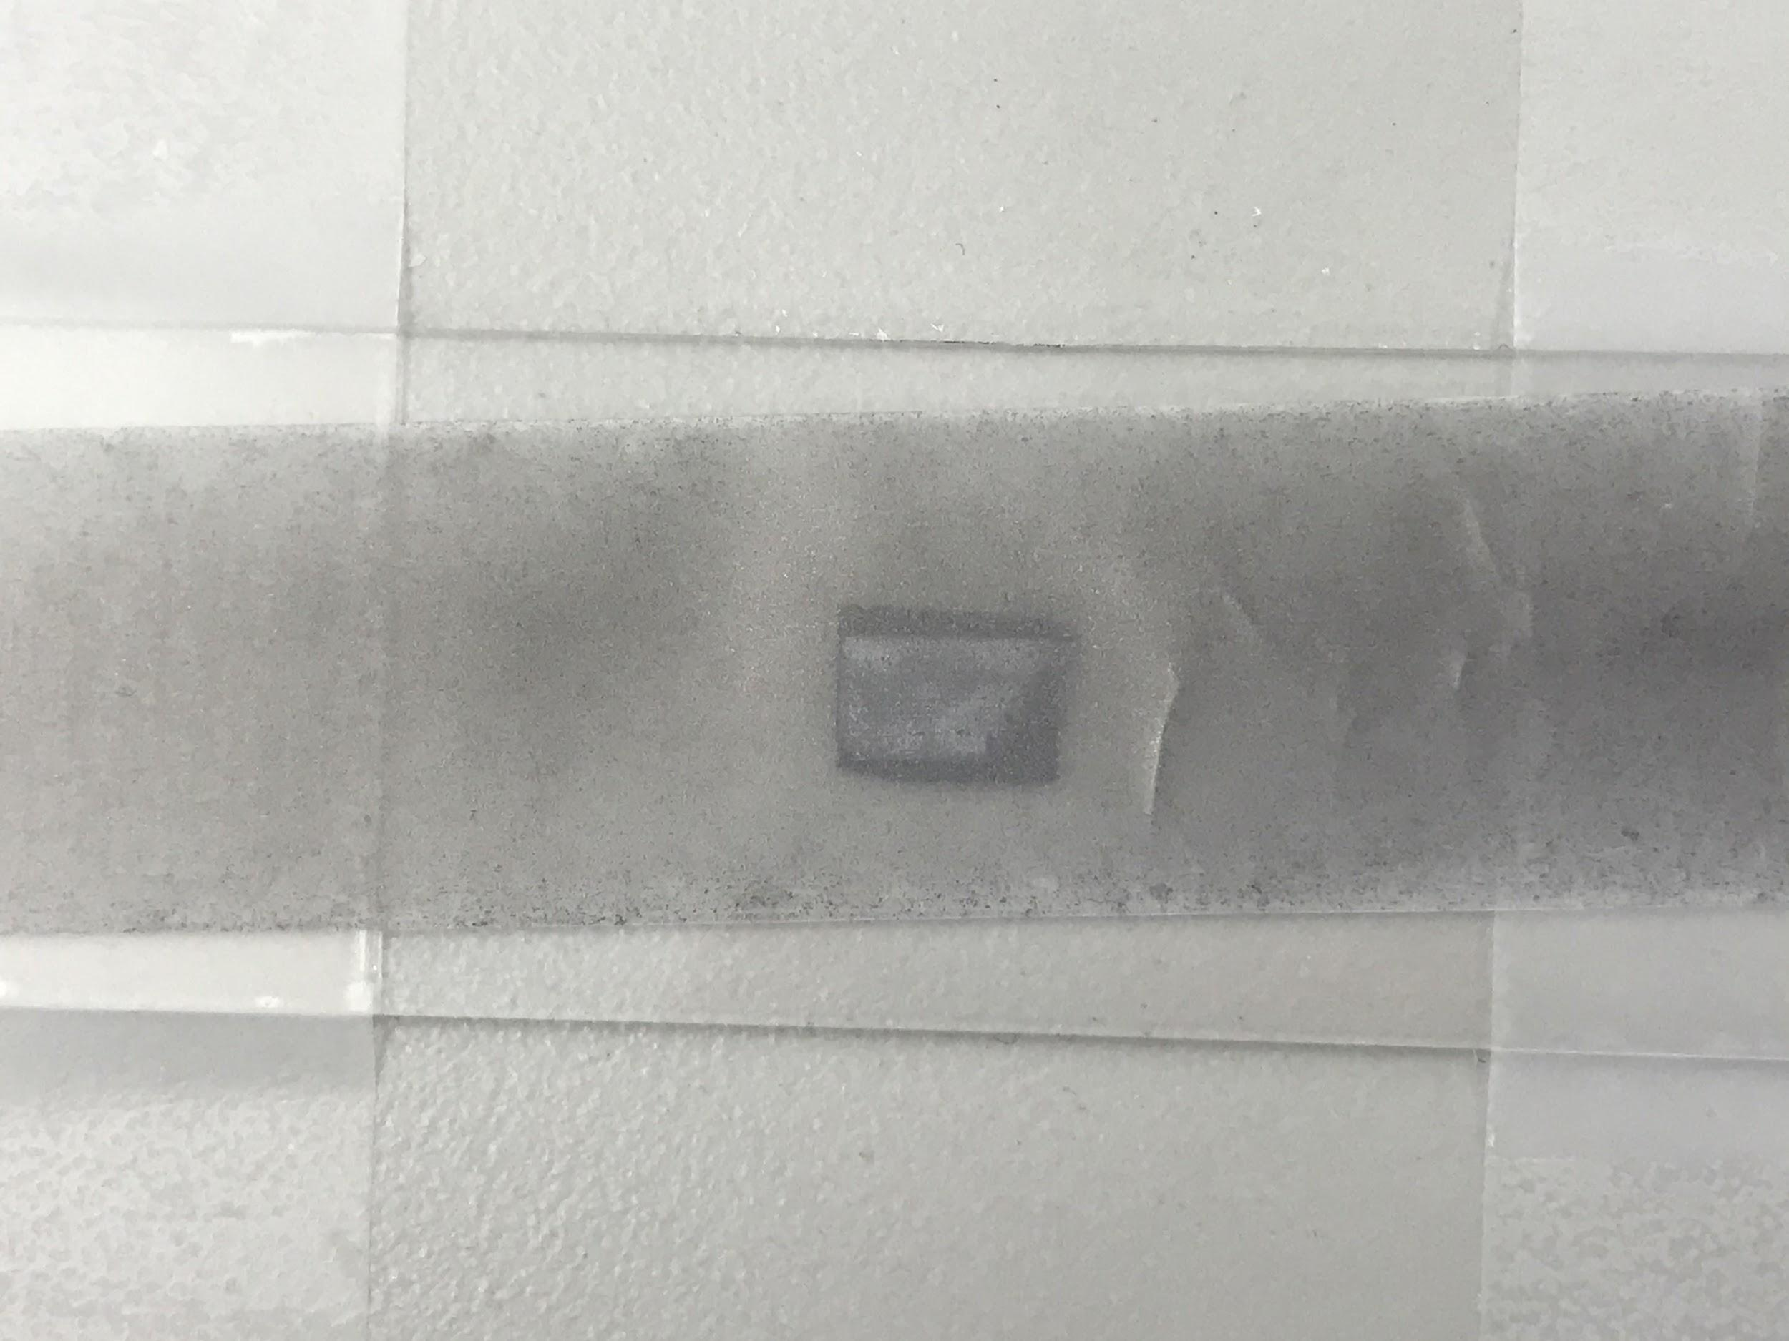
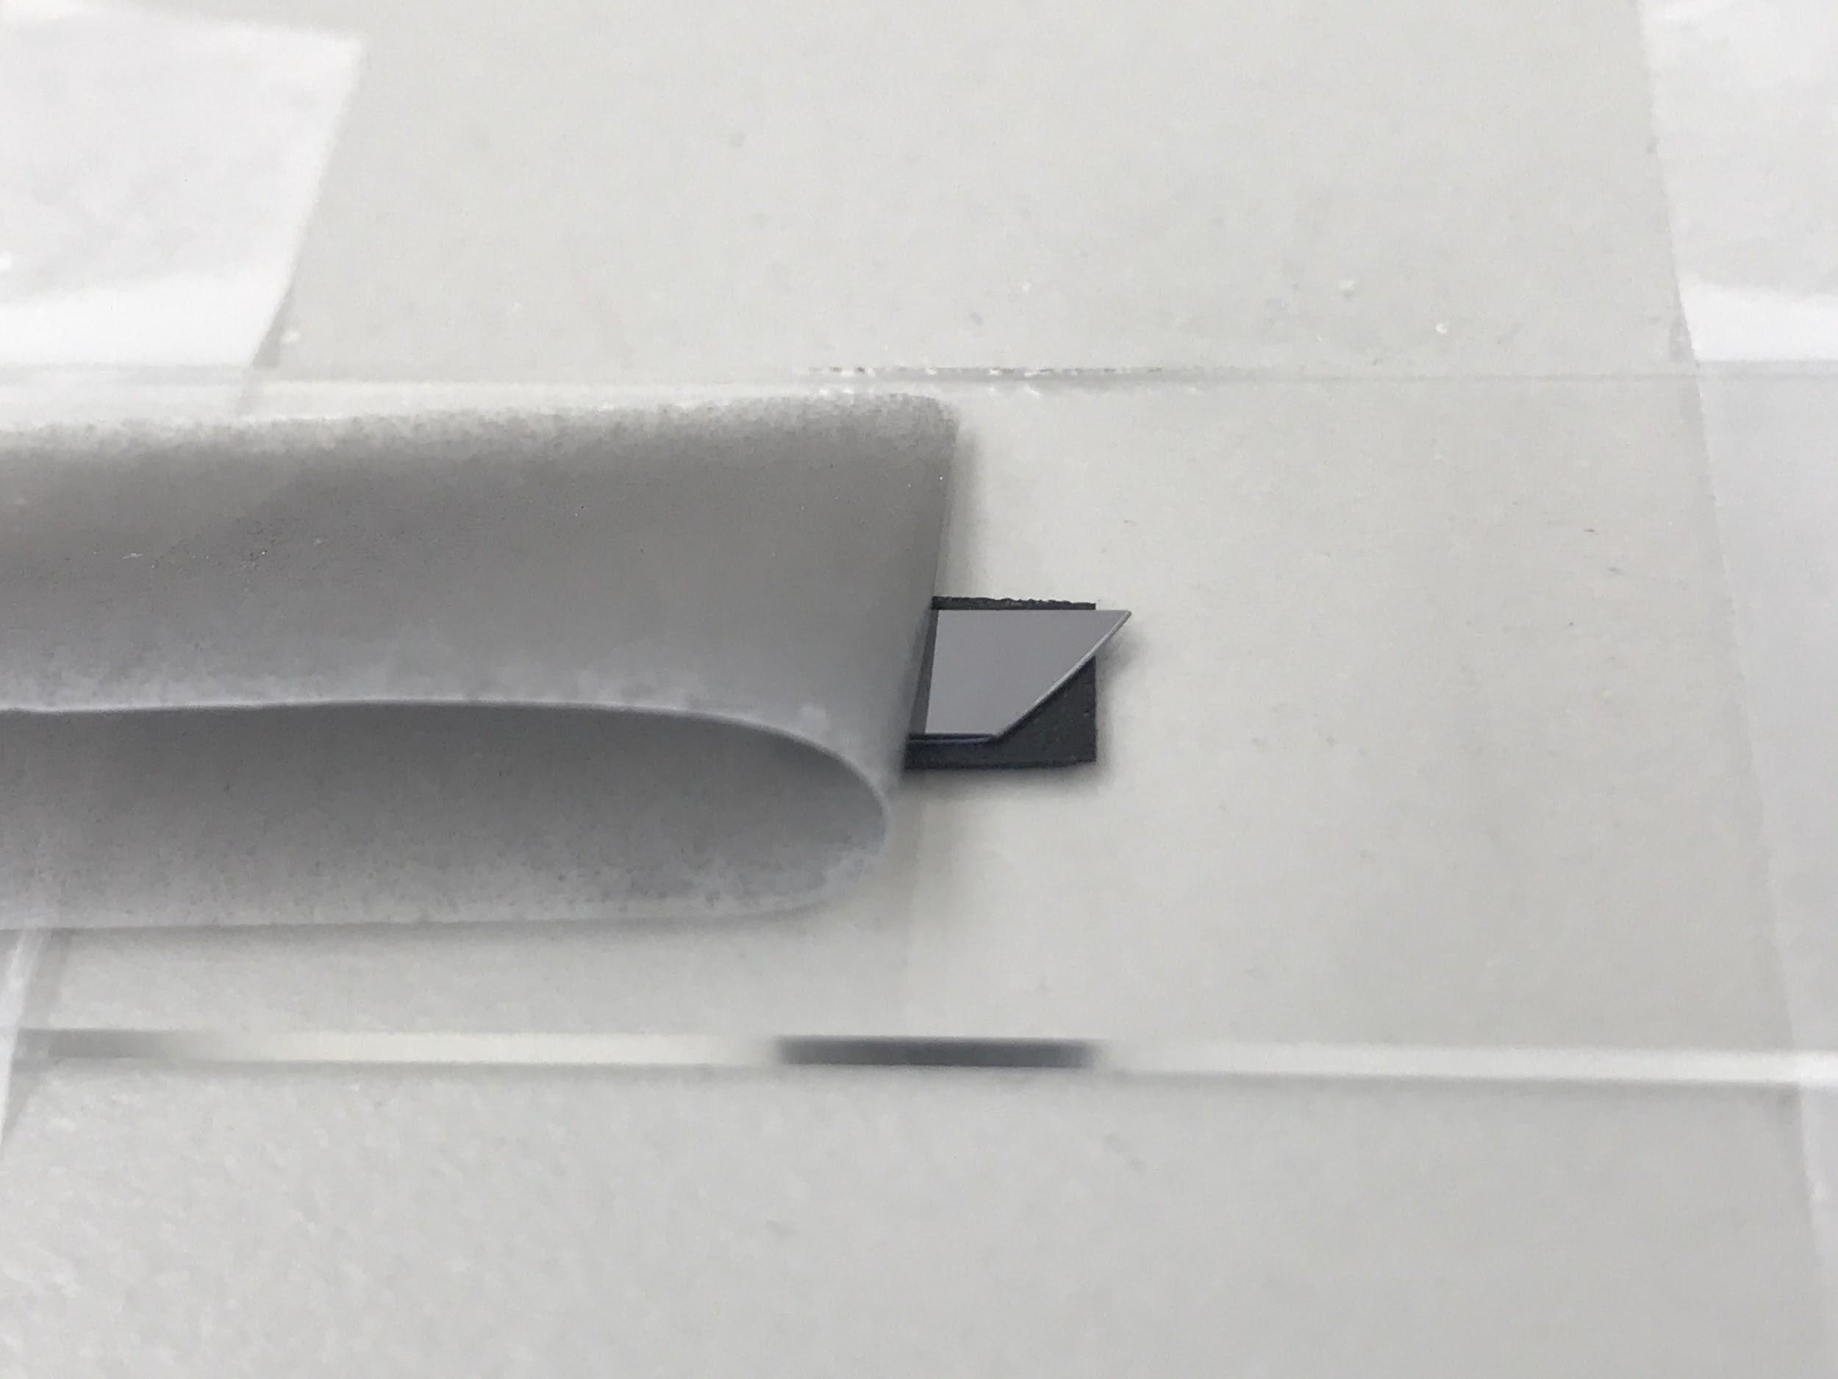
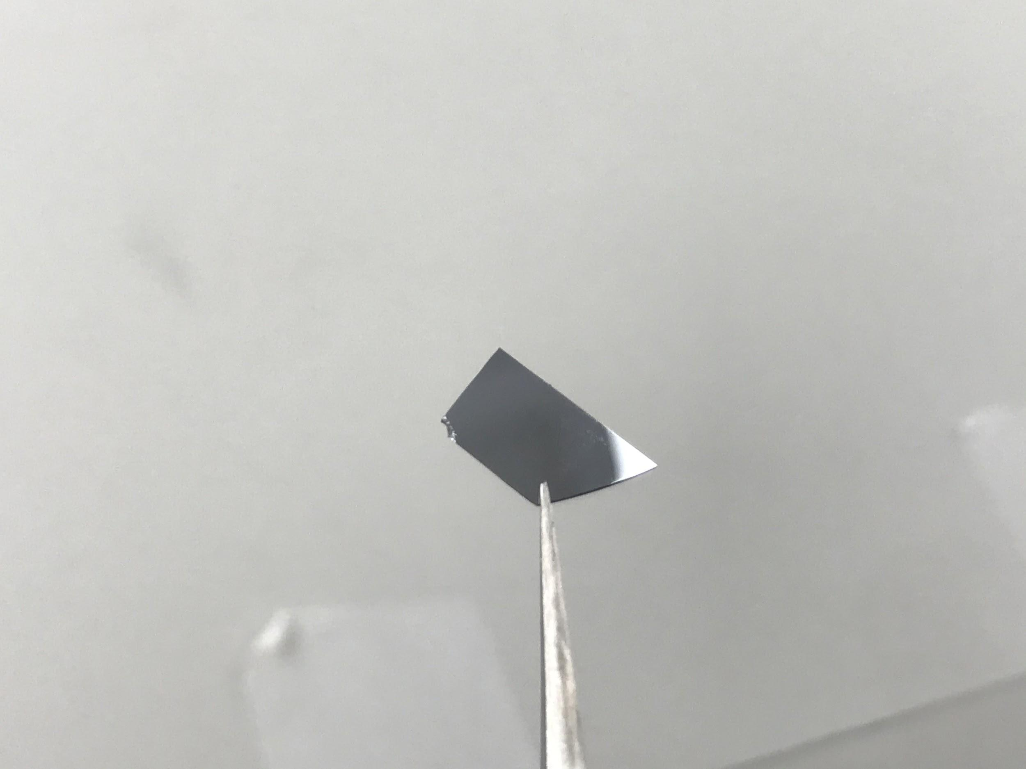
Scotch Tape
‹#›

Slide 6
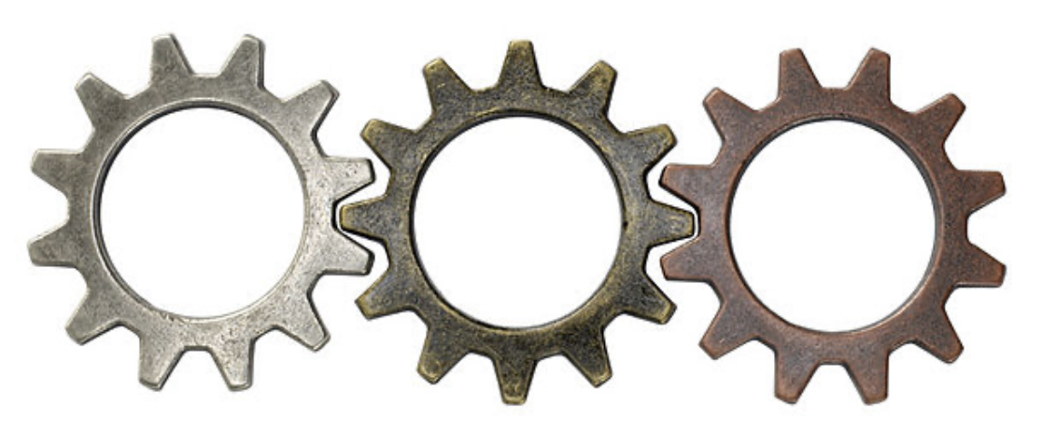
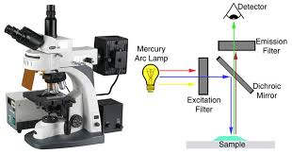
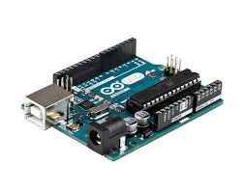
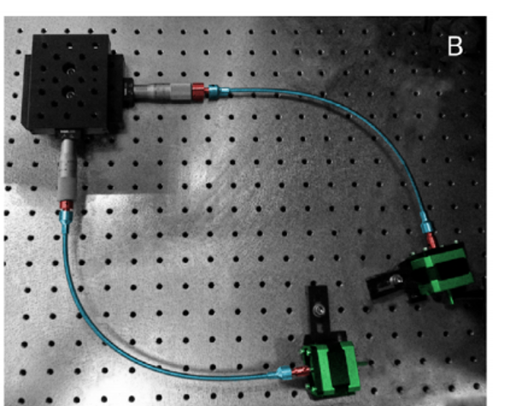
Automating graphene exfoliation and imaging
Peeling off
Exfoliation
Imaging
Nikki
Abigail
Eric
input: Scotch tape plus graphite
output: Graphene on SiO2 substrate plus a high resolution image of the wafer

Slide 7
Automatic Exfoliation Device
Nikki Ebadollahi

Slide 8
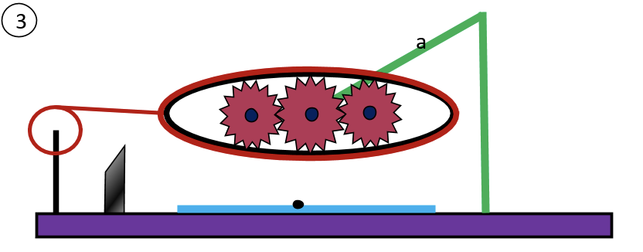
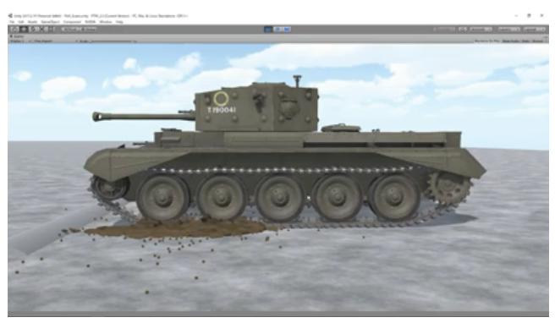
Automatic Exfoliator Design
Gear Design
Side View

Slide 9
Materials Needed to Build Exfoliator
3 Gears (1 Big & 2 Small) - Material: Steel
1 Belt - Material: Rubber
1 Motor - for Axial rotation of rod ‘a’
2 Long Rods
1 Short Rod
Tape
Blade
Base board
Arduino
3 Gears & 1 Belt
Tape & Rod
Motor
Blade
Graphite on tape

Slide 10
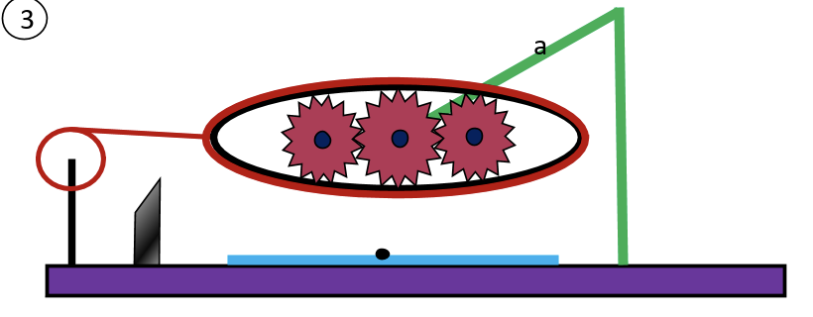
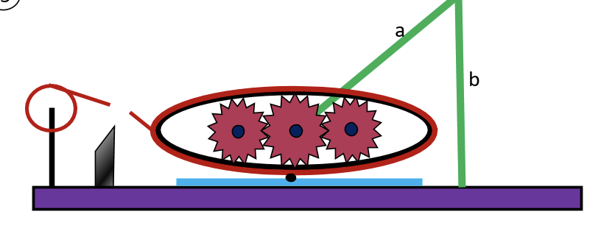
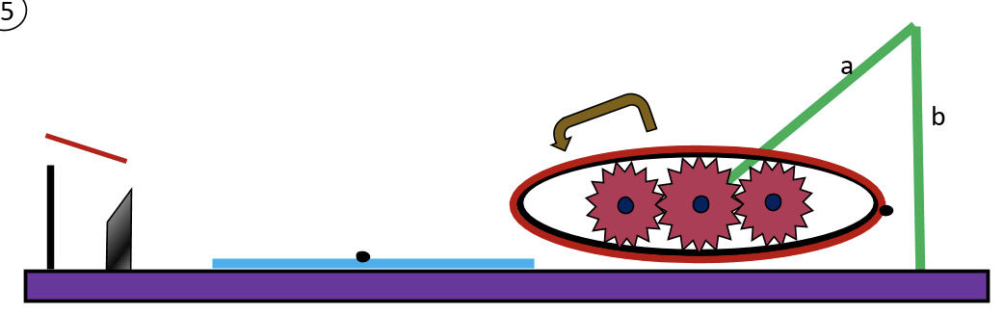
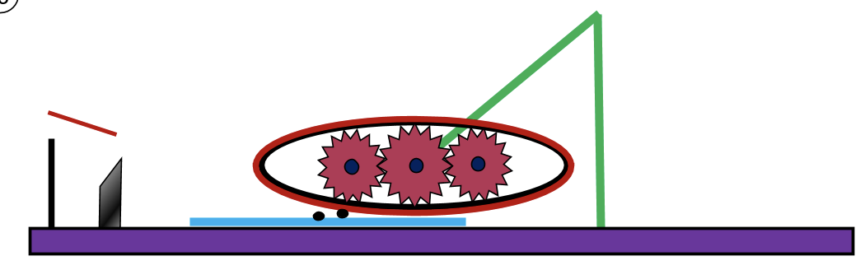
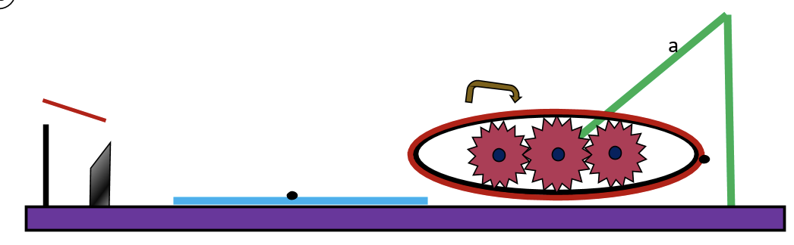
How the Exfoliator Works
Steps:
Tape surrounds the belt as rod ‘a’ turns around its axis.
Belt lowers onto the graphite on the base.
Belt moves to right of graphite & moves back to left to transfer graphite along the belts surface.
Steps 2 & 3 continues 10 times.

Slide 11
x-y stage
Abigail Martucci

Slide 12
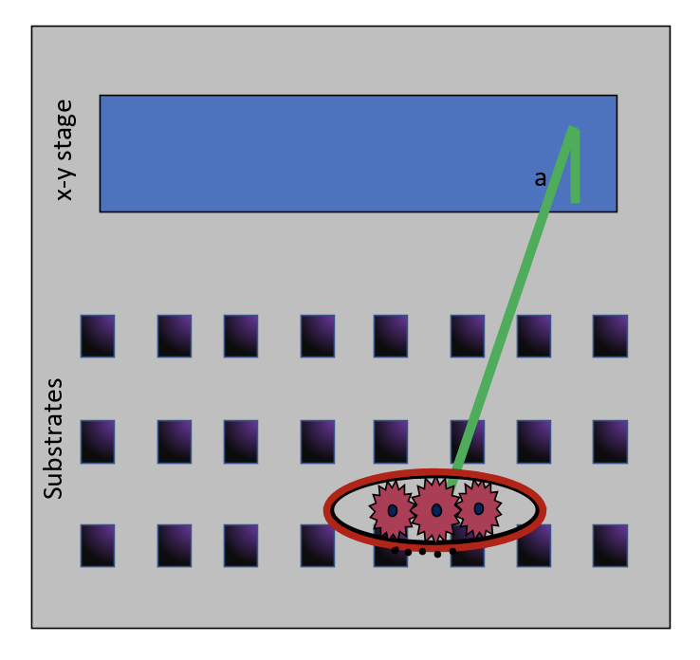
After doing a row, you want to move in the y direction and repeat the exfoliation using another row
Shaft Rotation using Arduino

Slide 13
Observation of Samples Using Optical Microscope
Eric Berg

Slide 14
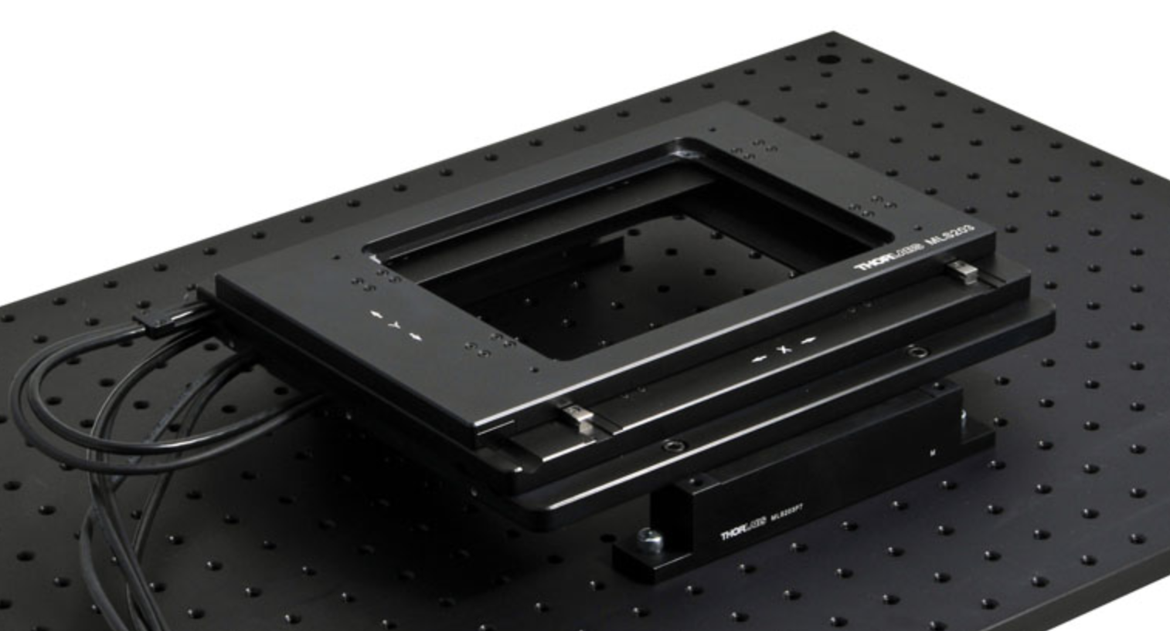
X-Y Stage: Option 1 (Buy from Thorlabs)
Pros:
Less work to set up
No need to create own commands
Could use pre made software
More resources for operation because others have similar setups
Would likely be very reliable
Min Achievable Incremental Movement - 0.1 µm
Cons:
More expensive
Would have to likely get a motor controller in addition to the stage to operate
Cost:
$7,531.55 - Fast XY Scanning Stage
$3,274.49 - 2-Channel Benchtop 3-Phase Brushless DC Servo Controller
$3,000 option - Slightly less precise but good enough for our purposes

Slide 15
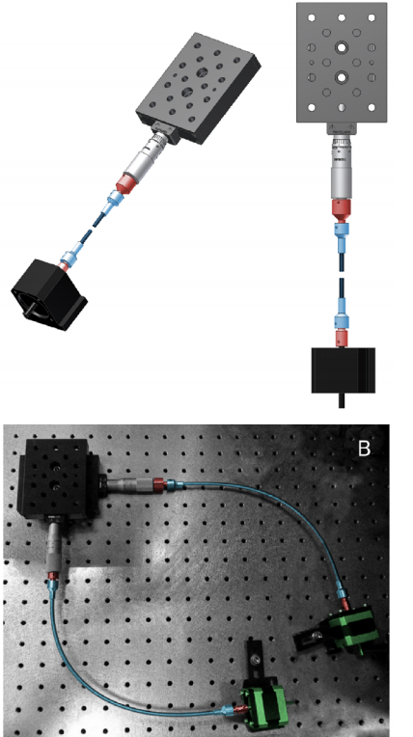
X-Y Stage: Option 2 (Normal Setup with Motors Attached)
Pros:
Could use materials that we are already familiar with
Adaptable for many different sized setups
Arduino interface may be more familiar
Minimum incremental motion of 0.1 µm in x-y plane and 0.04 µm in z
Cheaper (excluding stage, setup is below $1,000, in total ~$2000)
Resolution depends on types of knobs ordered, but about equal to thorlabs stage
Cons:
Would have to program ourselves through arduino
May be less reliable and could require more effort to maintain and use
Would take longer to set up
We could encounter more technical issues while programming as well as may be difficult to find the correct adapters for the specific knobs that we buy

Slide 16
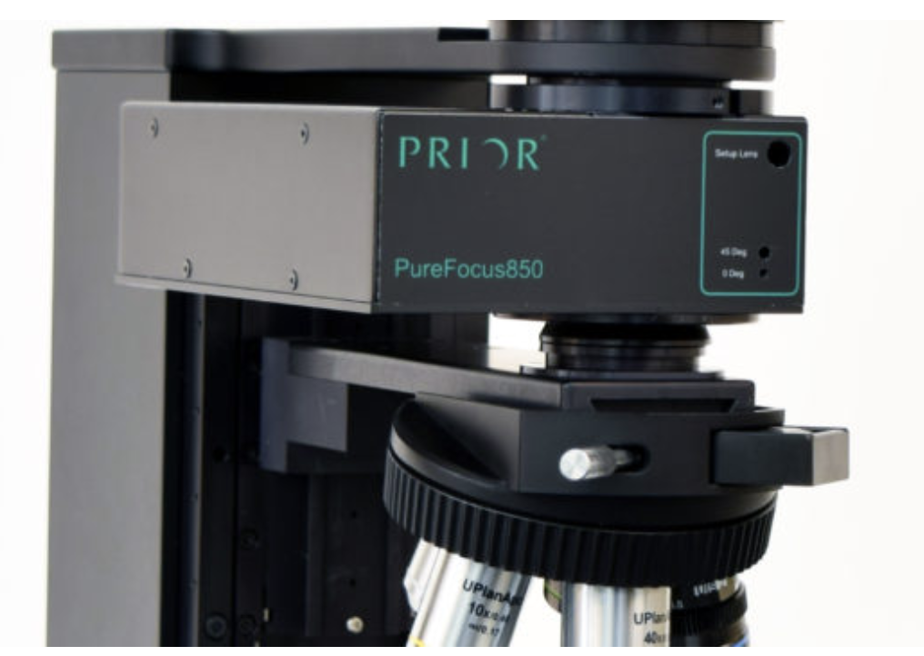
Focusing: Option 1 (Attachment Between Camera and Lens)
Pros:
Could easily be used with a microscope with the correct adapters
Would not have to program our own system would (hopefully) work reliably without much user input
No PC required but can also use keyboard to control it
Cons:
Need specific adapters to fit the focuser onto the microscope
More expensive than focusing camera
Laser focusing so may not work on all materials
May be more precise than necessary
Price - $11,000

Slide 17
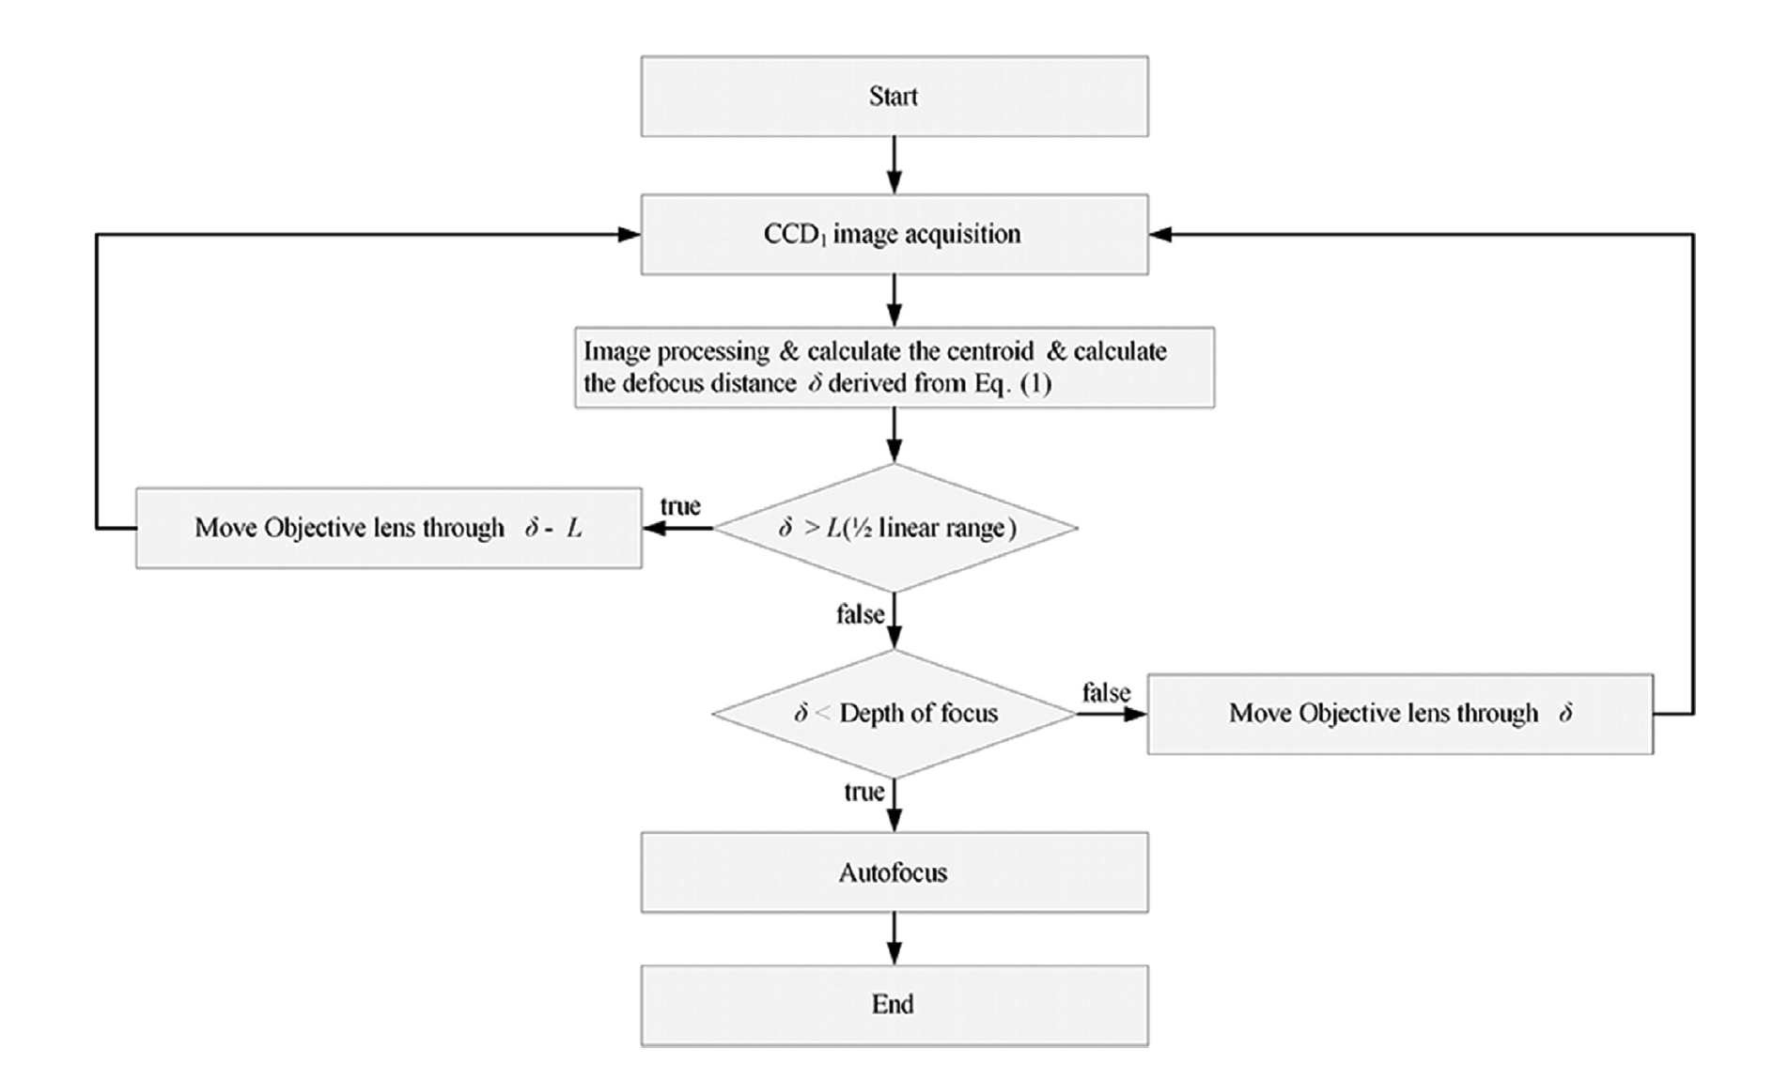
Focusing: Option 2 (Do it Ourselves)
Pros:
Deep low level control over the focuser
Likely cheaper than any other option (~250$ maximum)
Cons:
Would have to use a motor through an arduino to focus
A lot of work and time on our end required to create
In order to precisely autofocus many complex algorithms are used
We would need to build our own autofocusing system from the ground up through the arduino
May not work as well as we hope

Slide 18
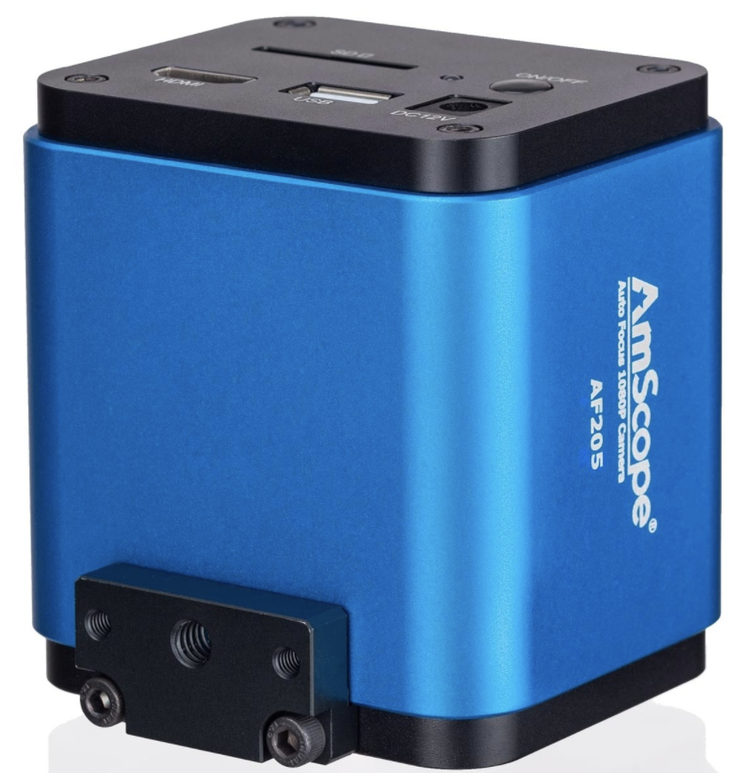
Focusing: Option 3 (Embed Focuser Within a Specialized Camera)
Pros:
Camera would do all focusing for us and we would do minimal work
After the object is roughly in focus the camera could automatically do fine adjustments to achieve focus while imaging
A simple and compact solution with minimal setup
If it does not work we would not need to take apart the whole setup the camera could be easily interchanged
Camera could be used for both optical microscope and transfer microscope if needed (many applications)
Cost - $800
Cons:
May not be as high resolution as a DSLR camera (5MP vs 12MP)
May have strange computer set up requirements, however this is not likely

Slide 19
3-Axis Helmholtz Ring
Bloch Sphere
Eva Gurra

Slide 20
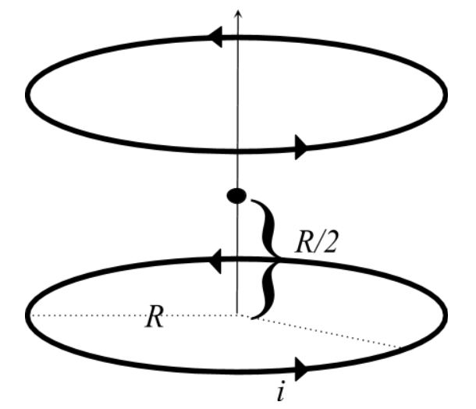
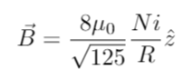
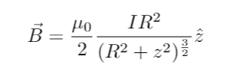
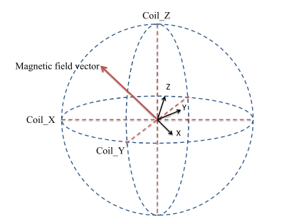
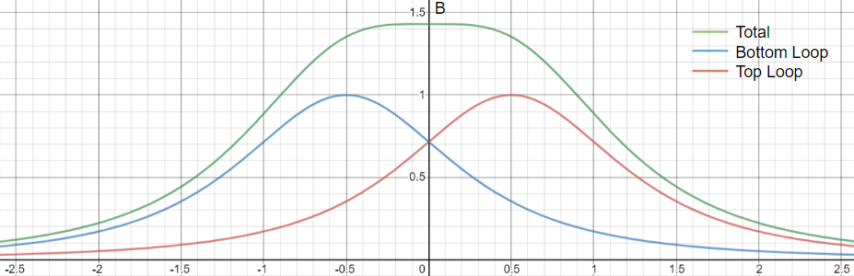
Background:
For N coil turns, the magnetic field in the center of the set of rings, separated by distance R is: (direction is determined via right hand rule)
If we orient the rings in the other two perpendicular directions we would have:
Magnetic field for a point a distance z away from the center of the ring:

Slide 21
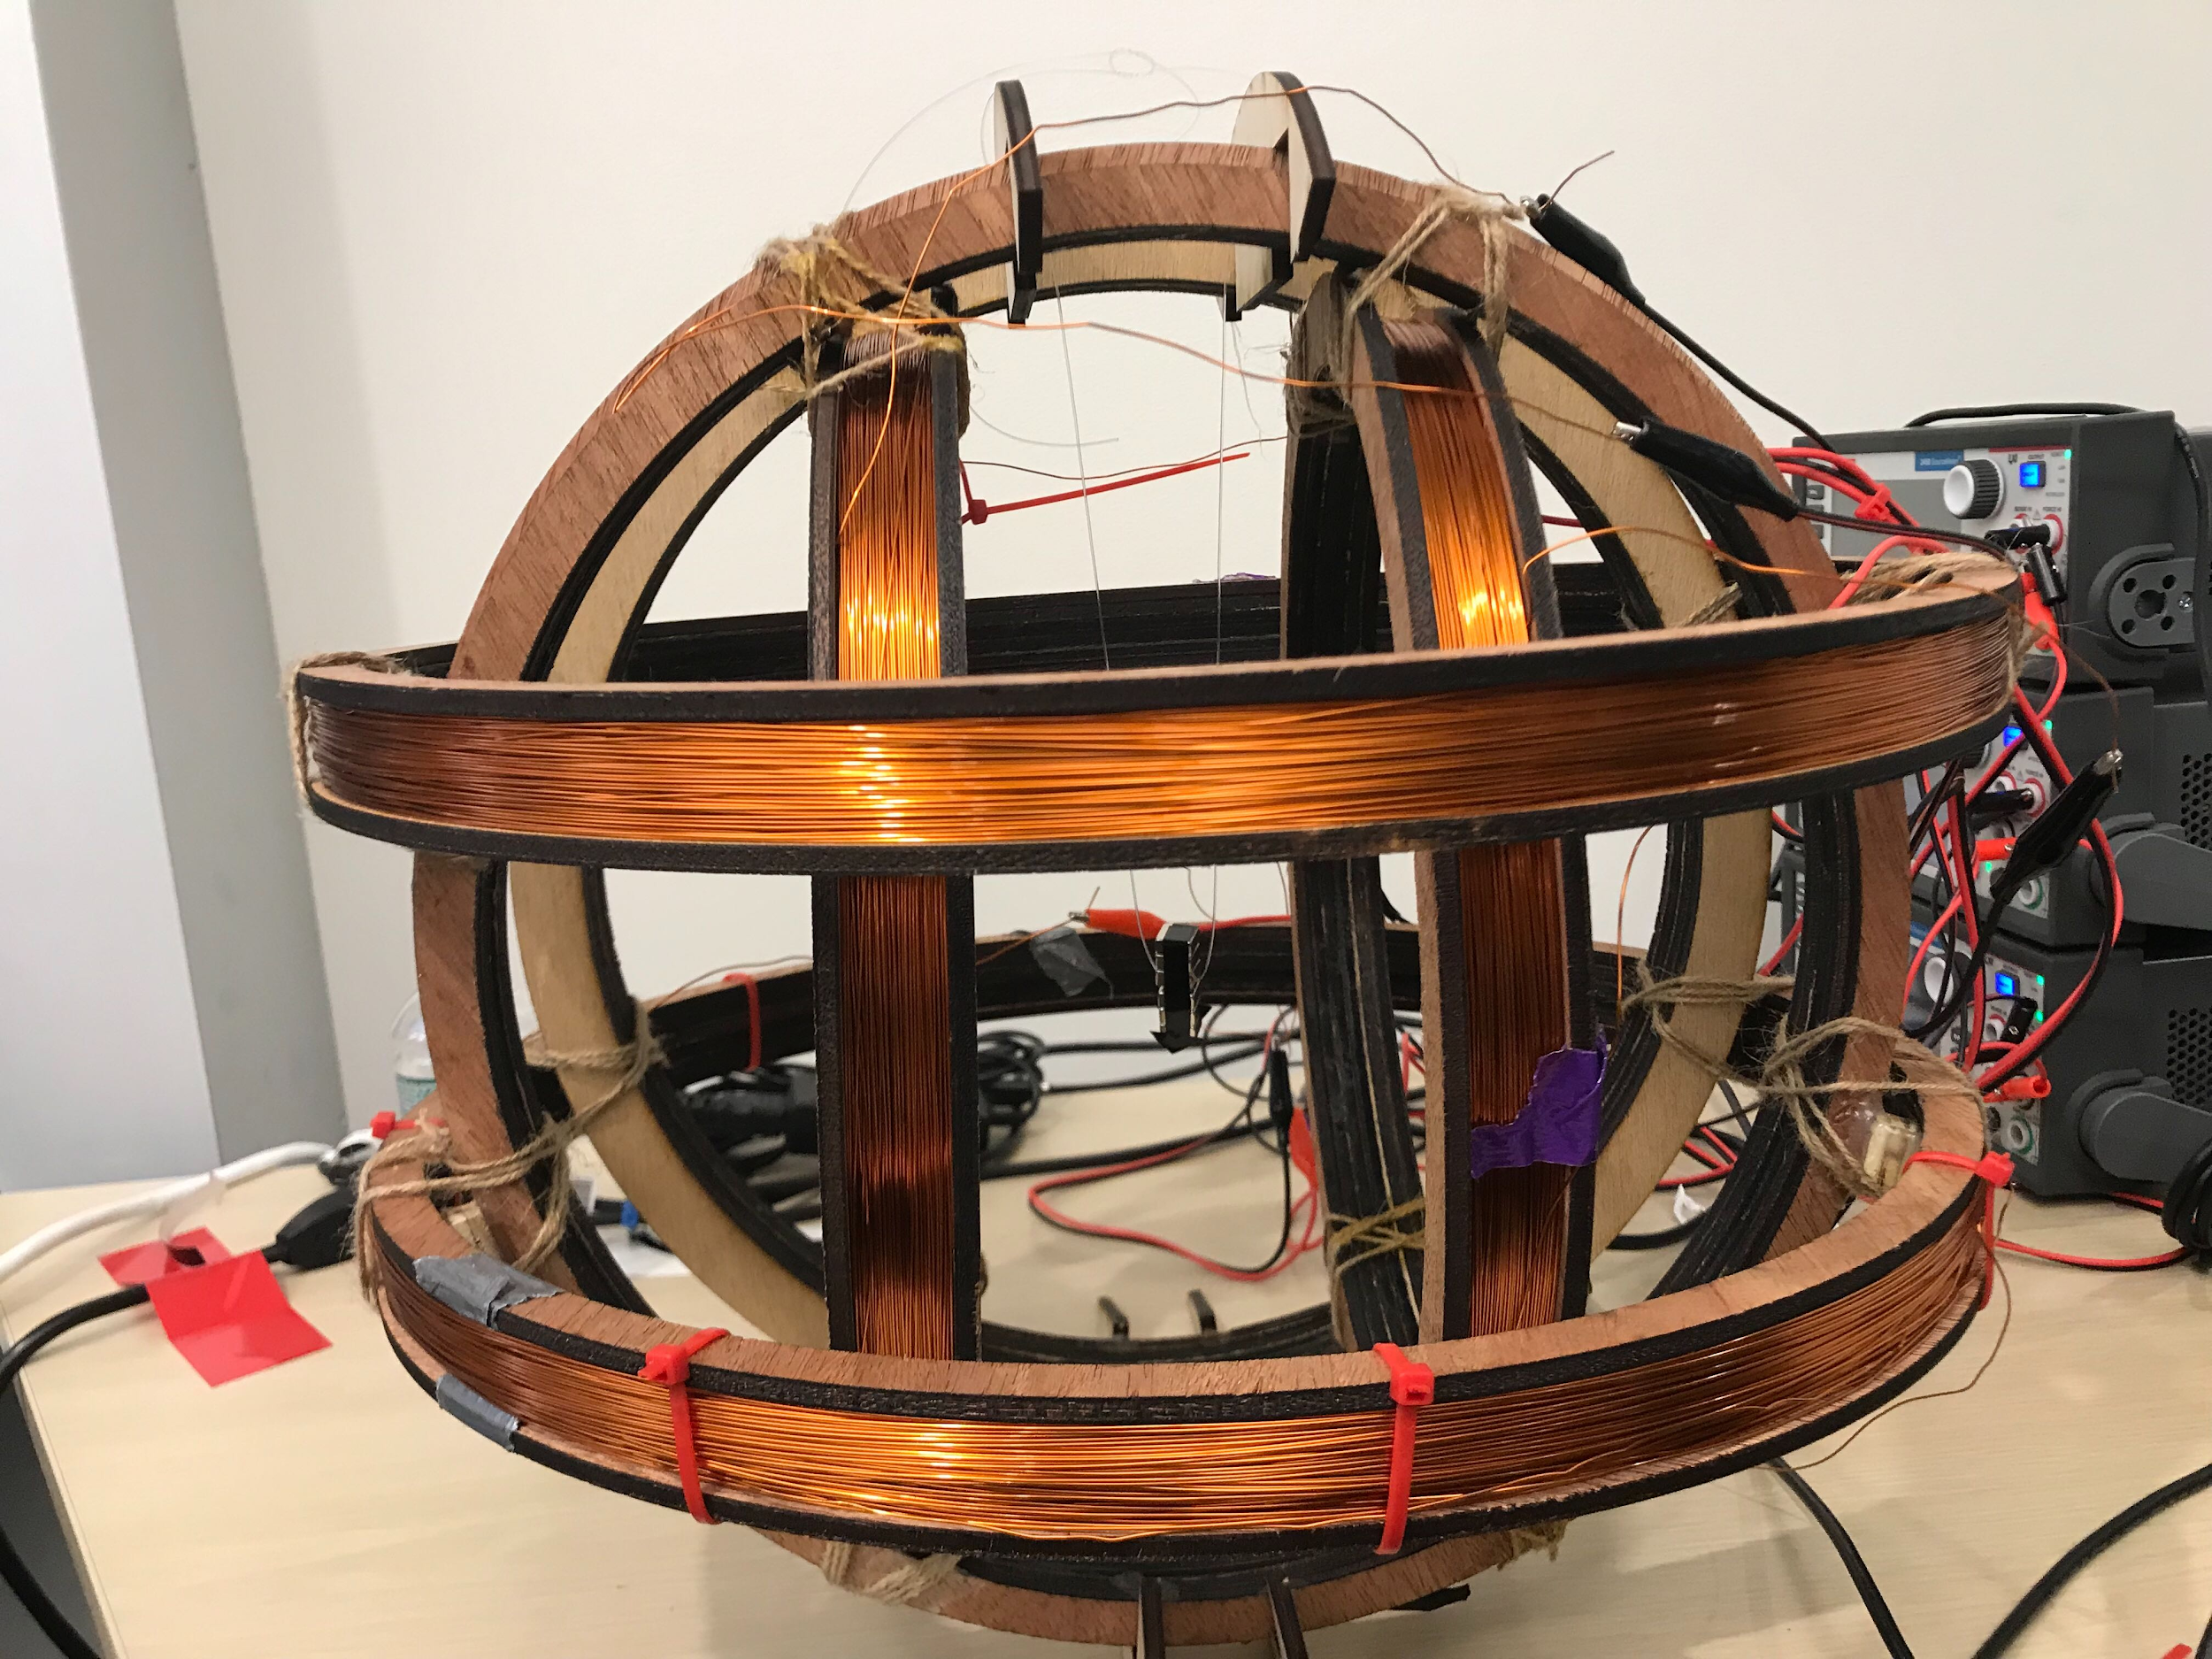
Summer 2019: Design
For each magnetic axis, the corresponding set of coils is connected in series to a power supply
Largest set of coils were about 15 inches in diameter with ~200 turns.
Biggest challenge was initializing z-axis appropriately so that middle piece can be rotated 180 degrees (X-gate)
Materials Used:
Wood
Magnetic Copper wire (AWG 22)
Magnetic ‘arrow’ in the middle
3 Keithley 2410 Source-meters (Cost: $16,890 !!!!)

Slide 22

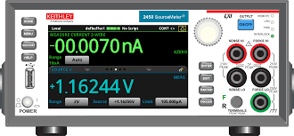
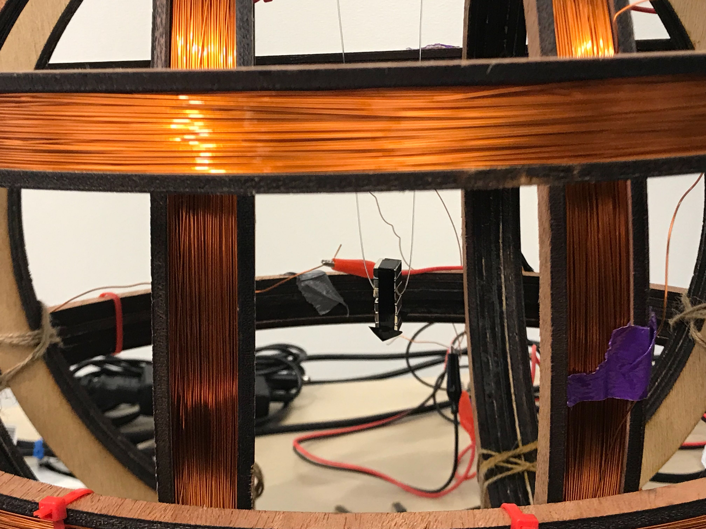

Summer 2019: Controls
Keithley 2450 Sourcemeter can be controlled through PyVisa.
Using a combination of PyVisa, SCPI commands and basic Qiskit functions we were able to automate the amount of current being sent by the power supply based on an a given 1-qubit circuit.
Input: 1-qubit circuit
PyVisa commands the Source meter to output current based on x,y,z component calculations of Qiskit circuit
Magnetic arrow moves to corresponding location.

Slide 23
Now What???
Main Goal:
Build 3 cheaper power supplies to replace Keithley's! (Cost: ~ $700-800 instead of $16,890)
Our Approach:
Using a DC/DC voltage regulator that has four-quadrant output capability with a programmable control pin.
Controlling regulator using RaspberryPi’s PWM pins which can be programmed through Python.
Problems:
We bought a regulator that claims four-quadrant output capability to test; but it currently does not behave as expected (only seems controls from -5 V to 0 V)
Notes:
PWM (Pulse Width Modulation) - method to control analog devices through digital output.

Slide 24
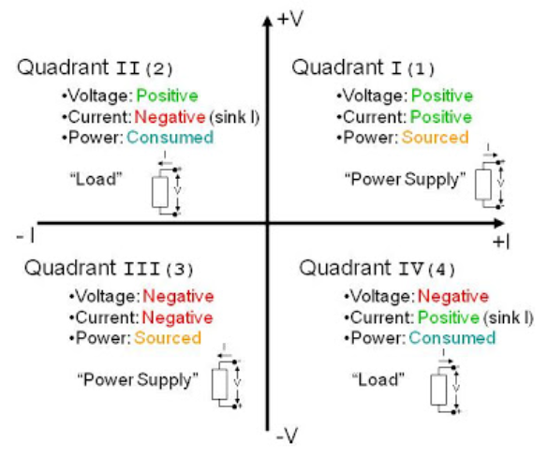
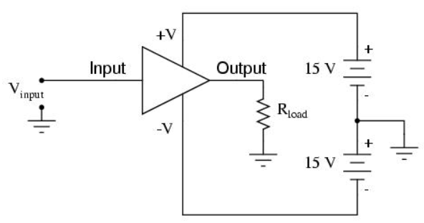
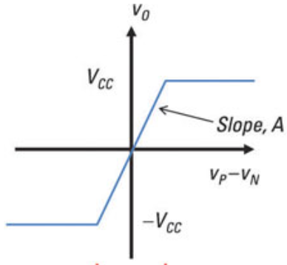
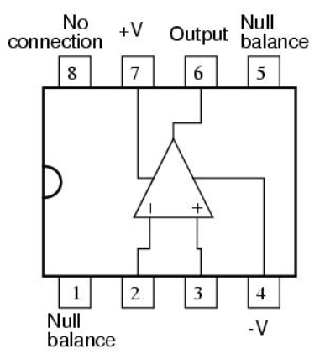
Four - Quadrant Capability
Supports both sourcing and sinking (consuming power) of current and bipolar voltage (+/- V).
Achieved through the use of op-amps:
Notes:
https://www.eleccircuit.com/simple-lm741-circuit/
Conventional power supplies support operation only in the first quadrant because they are sources.

